Slide 1
.Net Ria Services Developing Line of Business apps with Silverlight 3
Radenko Zec
radenko.zec@lanaco.com
http://blog.developers.ba/
http://twitter.com/radenkozec

Slide 2
About me

Slide 3
Agenda
Intro to .Net Ria Services
Entity framework, Linq to Sql, POCO support…
CRUD , sorting, filtering , grouping , batching
Client and server side validation
Dataform, Childwindow, Authentication
MVVM support, unit testing support
Offline support, Azure
Printing , SEO

Slide 4
NET RIA Services Vision and Goals
Simplify RIA development
n-tier is hard, and un-natural
Beyond accessing and editing rows
App-specific custom operations
Data shaping (sorting, paging, filtering)
Rules (validation, authorization, conflict handing)
Batching and offline
Supports Silverlight, ASP.NET, AJAX
In future WPF too

Slide 5
App Model that Spans Tiers
A single logical application
Client is an extension of the server
Rich Internet Application
Services
Browser
Web Application
HTML
Presentation
Logic
App
Logic
Data Access Layer
Network
DB
Services
Services
Other Applications

Slide 6
{ End-to-End Data Across Tiers }
Linq to sql support, grouping, filtering
demo one

Slide 7
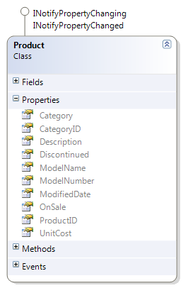
A Pattern that Scales and Grows
Support for multiple presentation tiers and data access technologies
.NET Clients
Silverlight, WPF
Databases
ADO.NET,
ORMs (LTS, EF, …)
Standards Clients
JavaScript
App
Logic
CLR Lists/Objects
Repository
(nHibernate, …)
Server Rendering
HTML, SEO,
Printing, …
XML, JSON, Binary
Services
REST/SOAP
(Azure, …)
Services
WCF
Unit Test Code

Slide 8
Silverlight 3 DataForm control
Similar to a vertical DataGrid
Supports Inserts, Updates and Deletes
Fully stylable, templetable
Metadata driven
Can act as a data navigation or simple detail view
Integrated with the Validation Framework

Slide 9
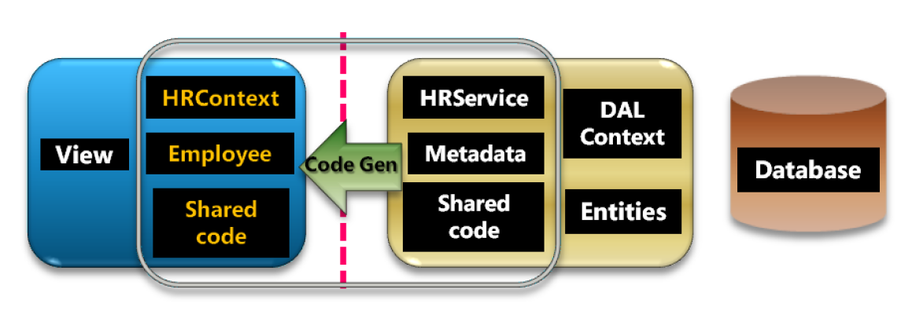
Sharing Metadata & Validation code

Slide 10
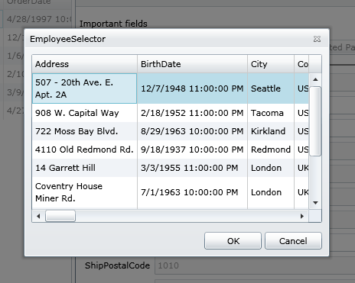
ChildWindow
Modal Animated Window
Draggable
Fully stylable & templetable

Slide 11
{ CRUD}
DataForm, crud, childwindow, validation, rules, metadata , batching
demo two

Slide 12
Some more stuff
Offline support – isolated storage
Azure support
[EnableClientAccess]
public class PeopleDomainService : AzureDomainService<NorthwindDataContext> {

Slide 13
{ POCO}
Poco support
demo three

Slide 14
Some more stuff again
Printing and Seo support
System.Web.DomainServices.WebControls.DomainDataSource

Slide 15
{ MVVM}
MVVM and Ria services
demo four

Slide 16
.Net Ria Services Roadmap
July 2009: Updated CTP
maybe remove production(go-live) restrictions
better shared code, extensibility and code-gen features
better integration with ADO.NET Data Services
PDC 2009: Beta
support for VS2010 and .NET 4 and move to ADO.NET Data Services as the underlying protocol
First part of 2010: RTW

Slide 17
References
http://www.nikhilk.net/
http://blogs.msdn.com/brada/
http://timheuer.com/blog/
http://www.cauldwell.net/patrick/blog/

